Slide 1
Heapsort and Priority Queues
CLRS Chapter 6.4 – 6.5

Slide 2
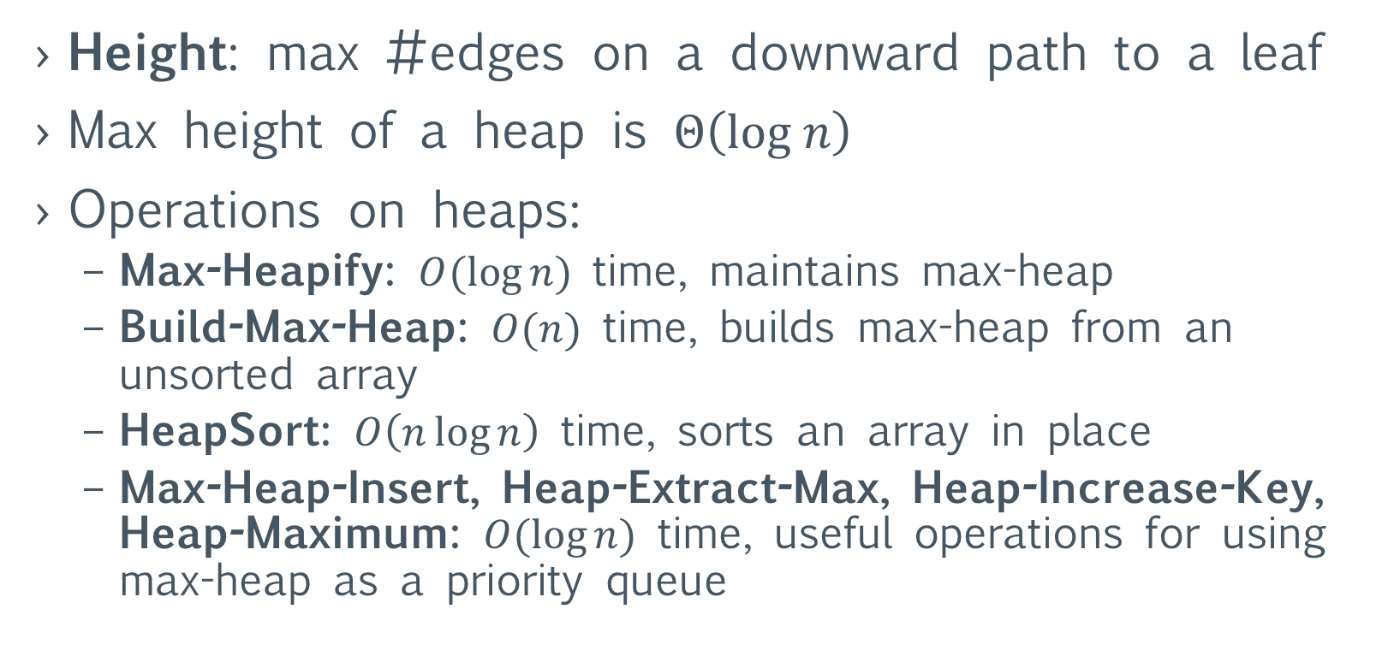
Reminder: Heaps and Heap Operations
Height: max #edges on a downward path to a leaf
Max height of a heap is $Θ\left(log n\right)$
Operations on heaps:
Max-Heapify: $O(\log{n})$ time, maintains max-heap
Build-Max-Heap: $O(n)$ time, builds max-heap from an unsorted array
HeapSort: $O\left(n\log{n}\right)$ time, sorts an array in place
Max-Heap-Insert, Heap-Extract-Max, Heap-Increase-Key, Heap-Maximum: $O(\log{n})$ time, useful operations for using max-heap as a priority queue

Slide 3
Heapsort Algorithm
Given: A[1…n]
First use Build-Max-Heap to build a max-heap
Swap A[1] with A[n]: now A[n] is correctly placed
After we decrement heap-size by 1:
Children of the root A[2] and A[3] are still max-heaps
A[1] might violate the heap property
Apply Max-Heapify(A,1) to fix the root
Get a max-heap on A[1…n-1]
Repeat after swapping A[1] and A[n-1] …

Slide 4
Heapsort Algorithm
Heapsort(A)
Build-Max-Heap(A)
For i = A.length downto 2
Swap A[1] with A[i]
A.heap-size = A.heap-size – 1
Max-Heapify(A,1)
Example A = [3, 2, 4, 1, 5, 6]

Slide 5
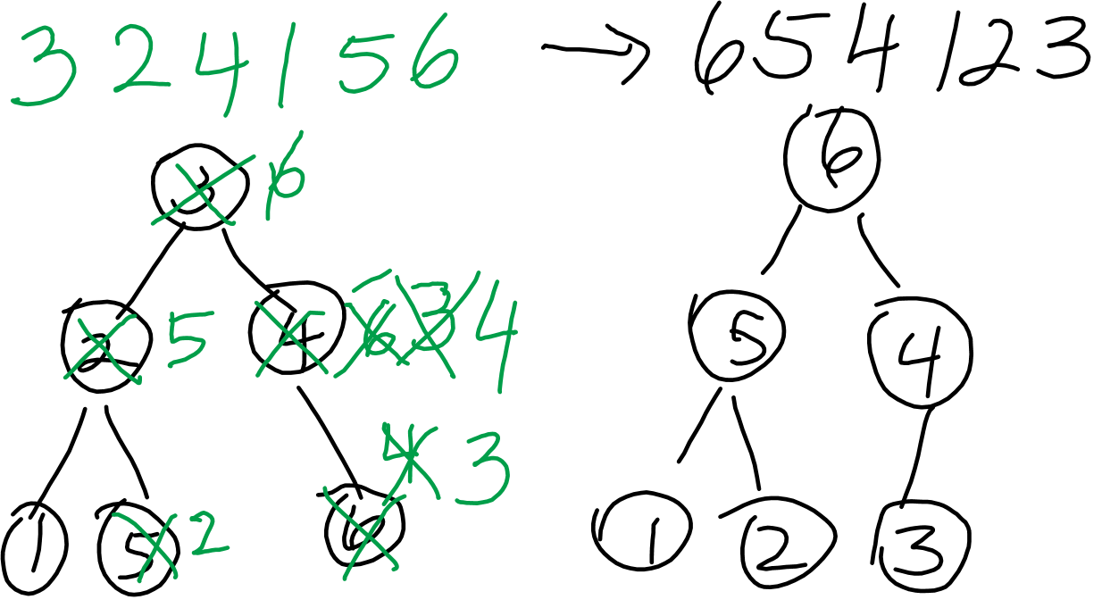

Slide 6
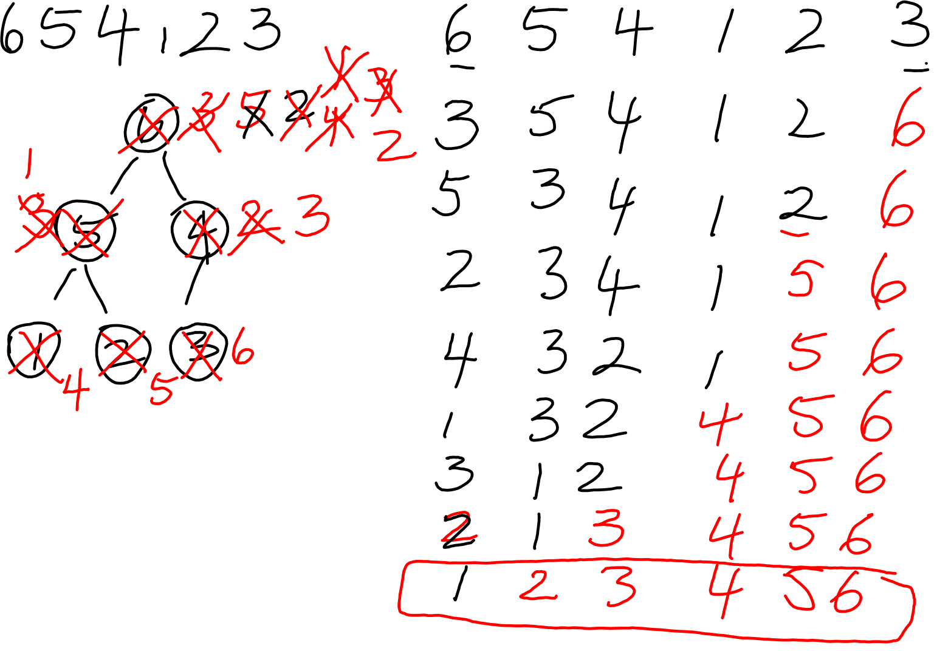

Slide 7
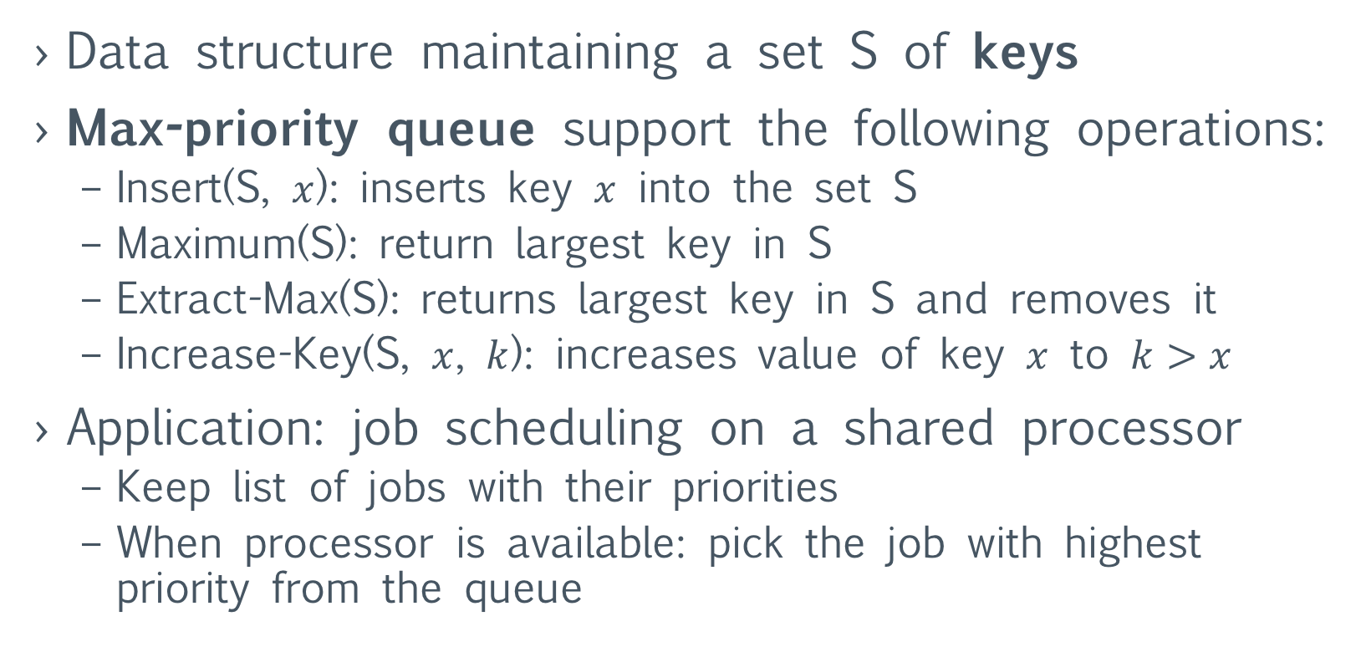
Priority queue
Data structure maintaining a set S of keys
Max-priority queue support the following operations:
Insert(S, $x$): inserts key $x$ into the set S
Maximum(S): return largest key in S
Extract-Max(S): returns largest key in S and removes it
Increase-Key(S, $x$, $k$): increases value of key $x$ to $k>x$
Application: job scheduling on a shared processor
Keep list of jobs with their priorities
When processor is available: pick the job with highest priority from the queue

Slide 8
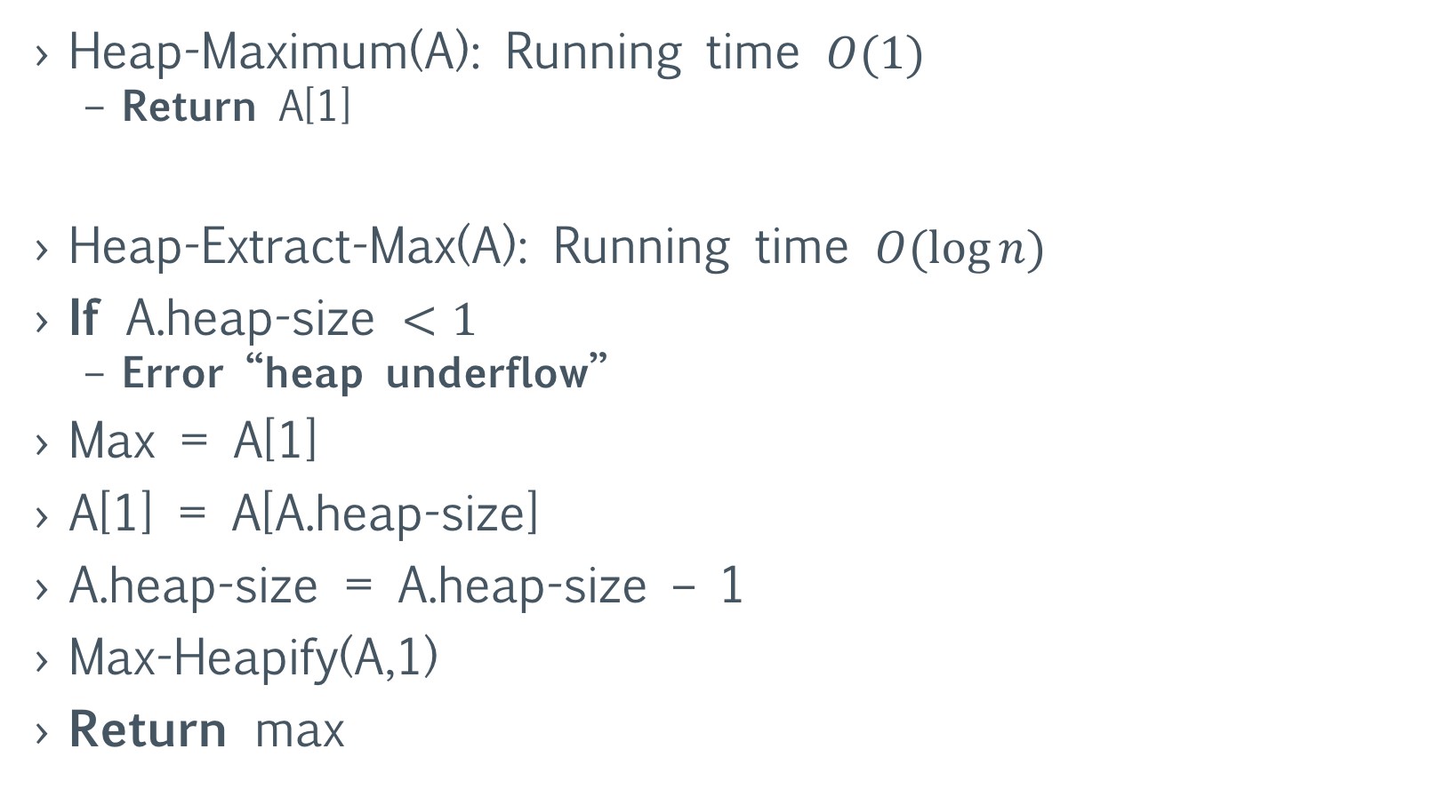
Implementing Maximum and Extract-Max
Heap-Maximum(A): Running time $O(1)$
Return A[1]
Heap-Extract-Max(A): Running time $O(\log{n})$
If A.heap-size $<1$
Error “heap underflow”
Max = A[1]
A[1] = A[A.heap-size]
A.heap-size = A.heap-size – 1
Max-Heapify(A,1)
Return max

Slide 9
Implementing Increase Key
Heap-Increase-Key implements Increase-Key
Index i locates elements whose key will be increased
First updates key of A[i] to its new value
Now A[i] might violate the heap property
Traverse the path upwards to fix the heap property
Repeatedly compare the element with its parent
If element’s key is larger than parents then exchange
Otherwise stop

Slide 10
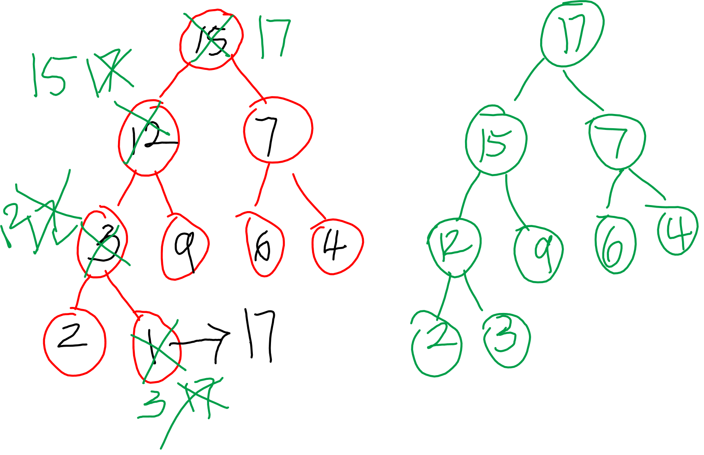

Slide 11
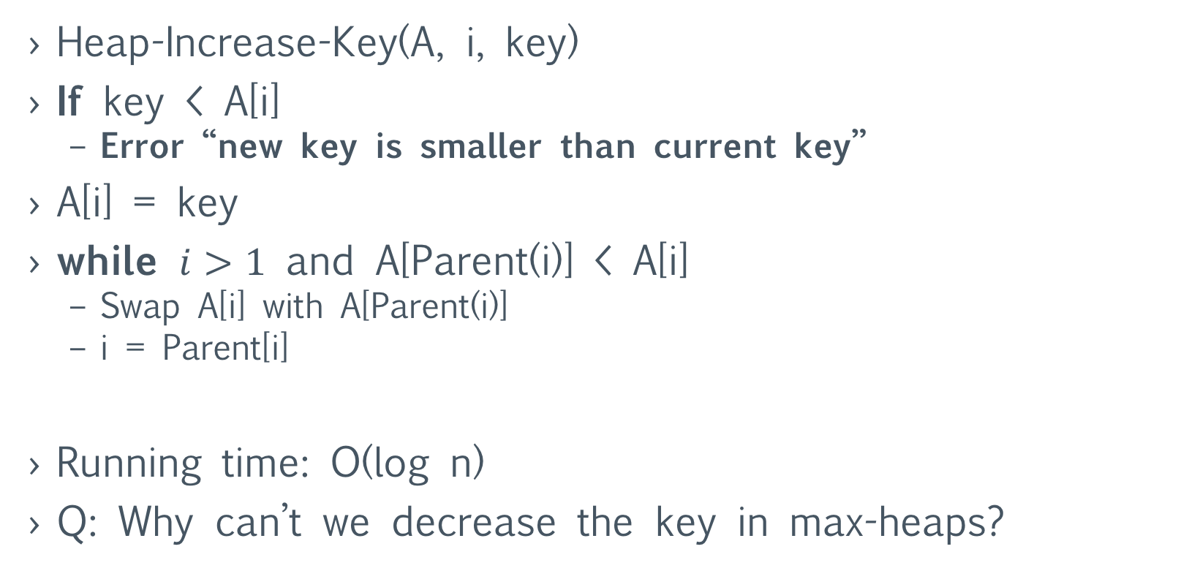
Implementing Increase-Key
Heap-Increase-Key(A, i, key)
If key < A[i]
Error “new key is smaller than current key”
A[i] = key
while $i>1$ and A[Parent(i)] < A[i]
Swap A[i] with A[Parent(i)]
i = Parent[i]
Running time: O(log n)
Q: Why can’t we decrease the key in max-heaps?

Slide 12
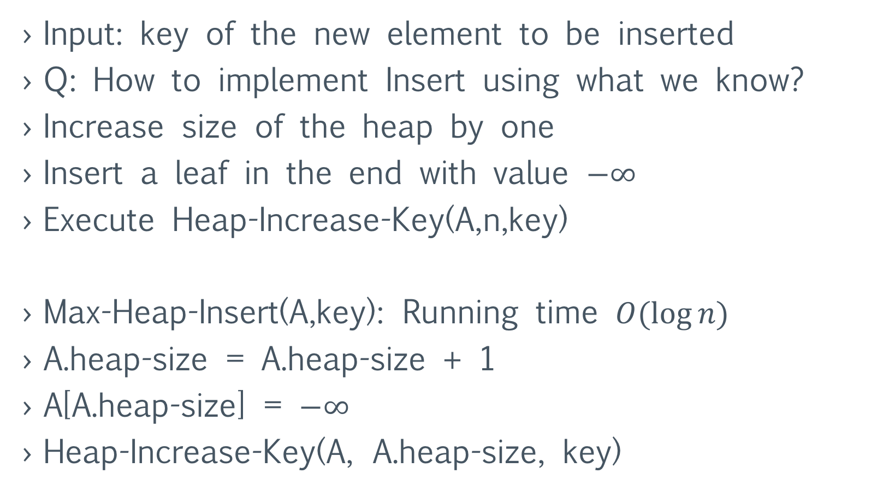
Implementing Insert
Input: key of the new element to be inserted
Q: How to implement Insert using what we know?
Increase size of the heap by one
Insert a leaf in the end with value $−∞$
Execute Heap-Increase-Key(A,n,key)
Max-Heap-Insert(A,key): Running time $O(\log{n})$
A.heap-size = A.heap-size + 1
A[A.heap-size] = $−∞$
Heap-Increase-Key(A, A.heap-size, key)

Slide 13
Example of Priority Queue Operations
Insert(1), Insert(2), Insert(5), Insert(3), Insert(7)
Extract-Max
Increase-Key(1,9)
Maximum
Insert(10)
Extract-Max

